Slide 1


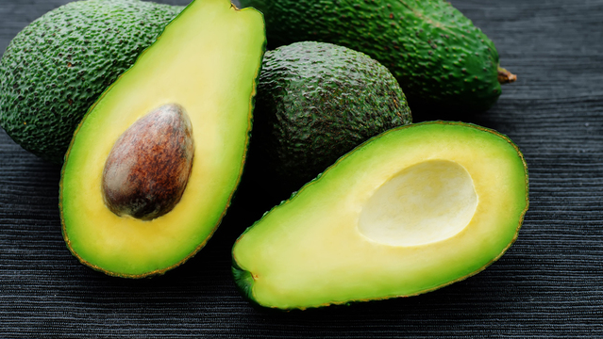

Avocado Price prediction Model
Created by Nobel Barua

Slide 2

Steps of Analysis
1)Exploratory data analysis
2)Answering the 4 question
3)scalizing the data
4 )Train with Linear regressor model and find the accuracy for test data and train data as predictor
5) Train the data with other regressor model
6)Compare the performance of all regressor model

Slide 3
Tools use
Data:Avocado data from class lecture
Tools: jupyter notebook, pandas, Numpy, scikitlearn, std.scaler

Slide 4
EDA findings
Data initial shape (18249, 14)
After removing unwanted column Data final shape are 18249 rows × 9 columns

Slide 5
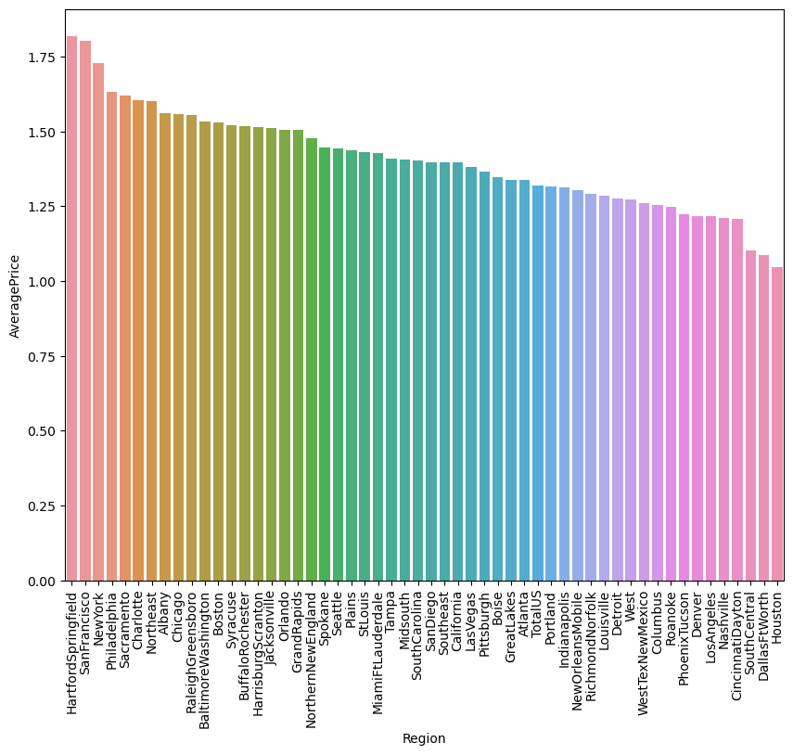
Answering the Questions
1st Q: Which region are the lowest and highest prices of Avocado?
Answer: Houston have lowest Average price and hartfordspringfiled have highest average price

Slide 6
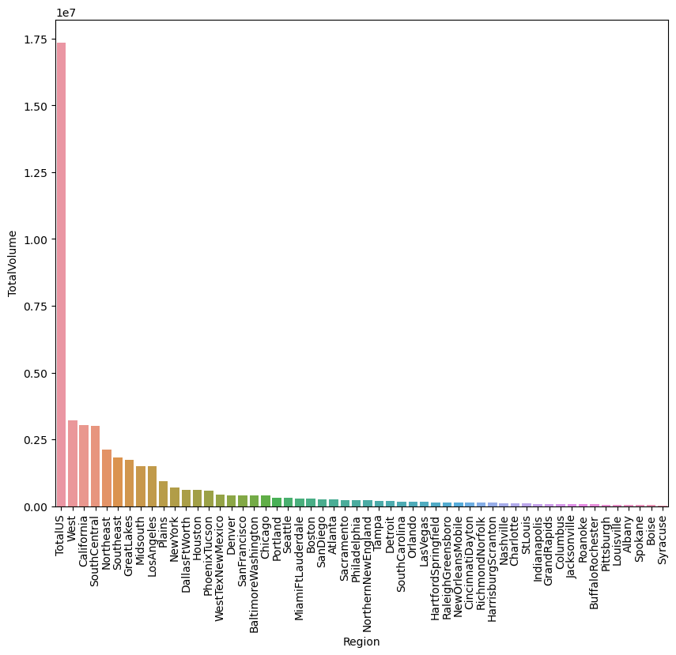
2ndQ: What is the highest region of avocado production?
Answer: Totalus is high production volume of avocado, From the figure we saw this bar is really high than other region,

Slide 7
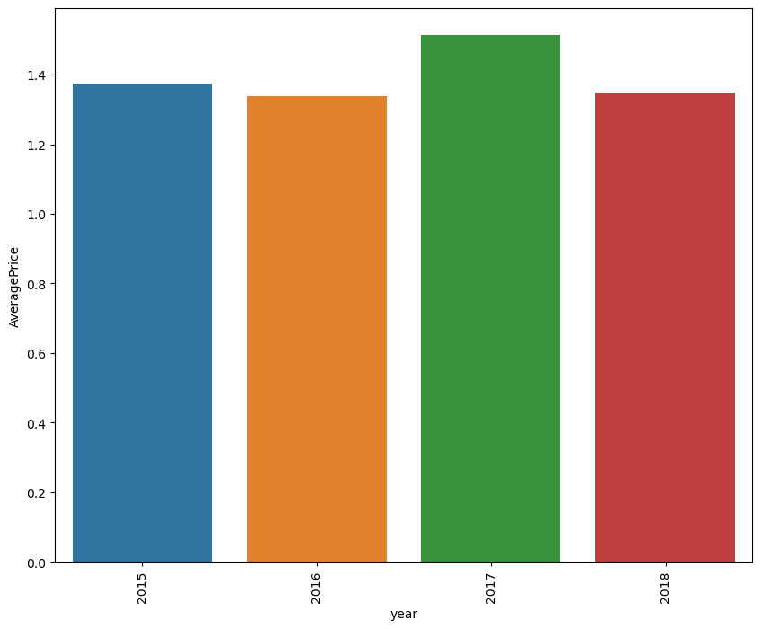
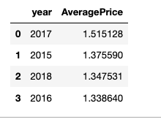
3rdQ: What is the average avocado prices in each year?
2017 is slightly high avocado price compared to others year

Slide 8
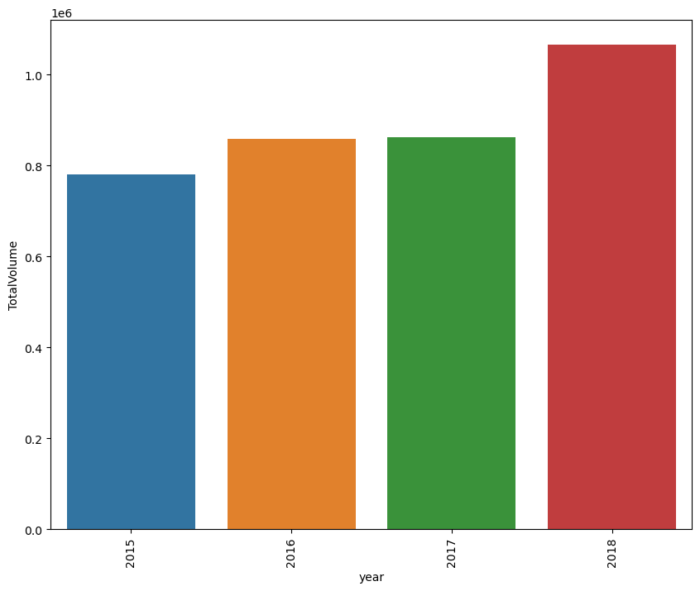
4thQ: What is the average avocado volume in each year?
2018 production is higher than the other years

Slide 9
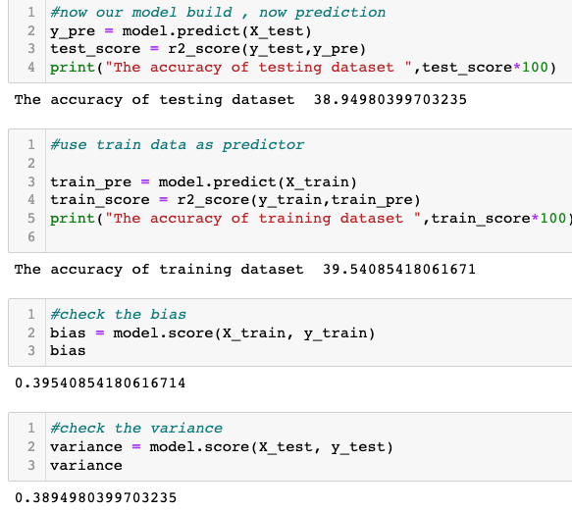
Linear regression model performance
As dependent variable avg.price is continuous chose linear regressor for prediction
The linear regression model accuracy is substantially low (39.89%), so this model is not appropriate with this data
Let's try with other regressor model and find their accuracy

Slide 10
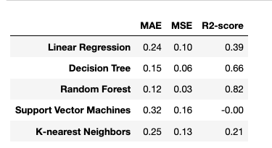
Build the other regressor model with this data and compare the MAE, MSE and R_square score
The table provides a comparison of the performance of different regression models based on the evaluation metrics. Lower MAE and MSE values and higher R2-scores generally indicate better model performance. Therefore, based on the given metrics, the random forest model appears to be the best performer among the listed models which R-Square is higher than the others model

Slide 11
Thanks for reading
Happy Coding and Than againks

